Slide 1
Perspective taking and microfiction
Activity created by Niall Peach, Purdue University.
Based on:
Arbelo, F. (2020, July 24). A. Monterroso, Por Frank Arbelo. Revista Muu+. https://revistamuu.com/2020/07/24/a-monterroso-por-frank-arbelo/

Slide 2
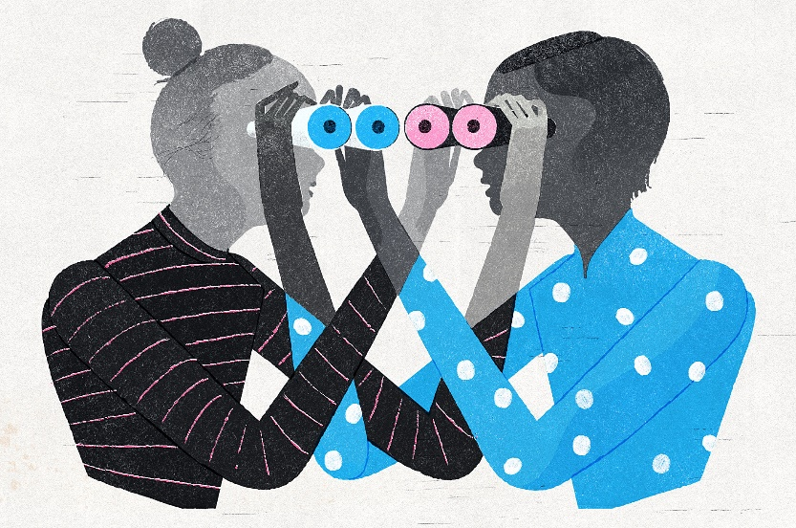
Perspective taking and microfiction
Perspective taking
What do you think perspective taking means?
What kinds of interactions require us to take another’s perspective?
How do differing perspectives affect communication?

Slide 3
Perspective taking and microfiction
Narrative perspective
What information do we have?
What do you think is happening in this narrative?

Slide 4
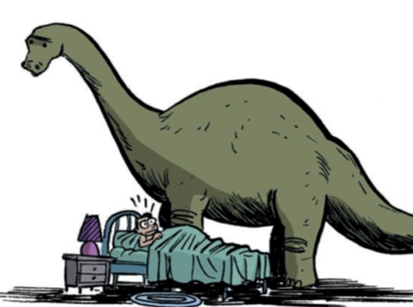
Perspective taking and microfiction
When he/she/it woke up the dinosaur was still there.
Whose perspective do we see?
How do you understand the dinosaur in this image?
What is the relationship between the dinosaur and the main character (positive/negative/ambiguous?) Explain.

Slide 5
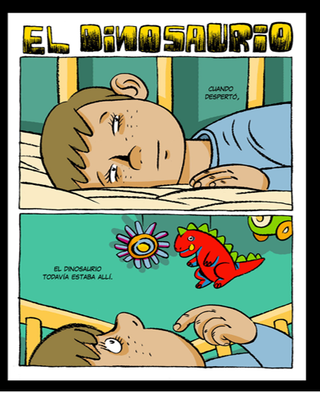
Perspective taking and microfiction
When he/she/it woke up the dinosaur was still there.
Whose perspective do we see?
How do you understand the dinosaur in this image?
What is the relationship between the dinosaur and the main character (positive/negative/ambiguous?) Explain.

Slide 6
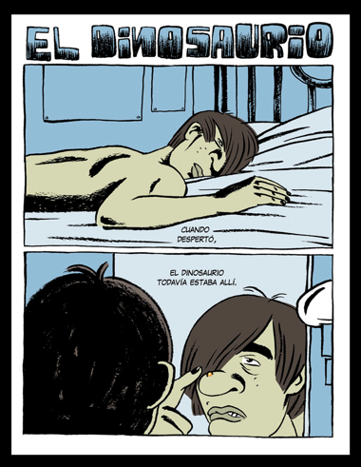
Perspective taking and microfiction
When he/she/it woke up the dinosaur was still there.
Whose perspective do we see?
How do you understand the dinosaur in this image?
What is the relationship between the dinosaur and the main character (positive/negative/ambiguous?) Explain.

Slide 7
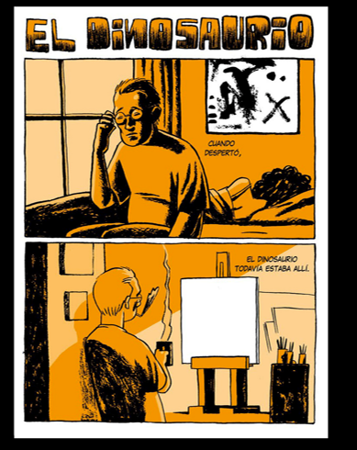
Perspective taking and microfiction
When he/she/it woke up the dinosaur was still there.
Whose perspective do we see?
How do you understand the dinosaur in this image?
What is the relationship between the dinosaur and the main character (positive/negative/ambiguous?) Explain.

Slide 8
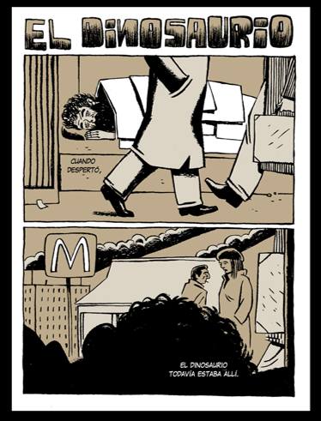
Perspective taking and microfiction
When he/she/it woke up the dinosaur was still there.
Whose perspective do we see?
How do you understand the dinosaur in this image?
What is the relationship between the dinosaur and the main character (positive/negative/ambiguous?) Explain.

Slide 9
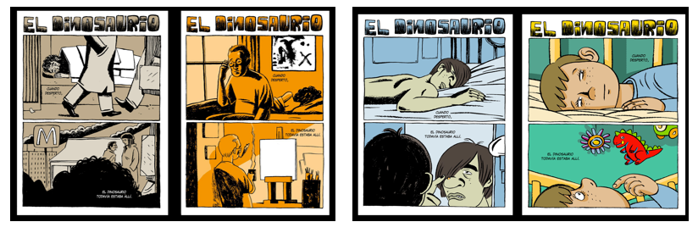
Perspective taking and microfiction
What do you feel when you see each image with the dinosaur? Why?
How have you taken a perspective on what you have just seen?
How did our experiences influence our opinions of the 4 interpretations?
Notes:
What do you feel when you see each image with the dinosaur? Why?
How have you taken a perspective on what you have just seen?
How does it feel when others share your perspective on these images? How does it feel when they don’t?
How can you apply what you’ve learned about perspective taking and communication?

Slide 10
Perspective taking and microfiction
How does it feel when others share your perspective on these images? How does it feel when they don’t?
How can you apply what you’ve learned about perspective taking and communication?
What role does perspective taking have in your daily communication?

